Slide 1
StyleMapGAN [AICP] interactive video style transfer
Ha yeon, KIM
24th June, 2022

Slide 2
Abstract
Editing real images with GANs
Time consuming optimization for projecting real images to the latent vectors
Inaccurate embedding through an encoder
Editing real images with StyleMapGAN
Intermediate latent space has spatial dimensions
Spatially variant modulation replaces AdaIN
“Make the embedding through an encoder
more accurate while maintaining the properties of GANs”

Slide 3
Introduction
GAN : naturally learn to encode rich semantics within the latent space,
thus changing the latent code leads to manipulating
the corresponding attributes of the output images
-> But, challenging to apply these manipulations to real images
since the GAN lacks an inverse mapping from an image back to its corresponding latent code.
Solution
i2i : requires pre-defined tasks and heavy supervision(input-output pairs, class labels etc)
Pretrained GAN by optimizing the latent code : doesn’t guaranteed that optimized code
Would be placed in the original latent space of GAN
3) Train extra encoder : low fidelity
-> absence of spatial dimensions(compress image’s local semantic into a vector in entangled manner)
Stylemap(tensor with explicit spatial dimensions)

Slide 4
Goal
Our goal is to project images to a latent space
accurately with an encoder in real-time and
locally manipulate images on the latent space.
StyleMap & Spatially variant modulation
(style map = intermediate latent space with spatial dimensions)

Slide 5
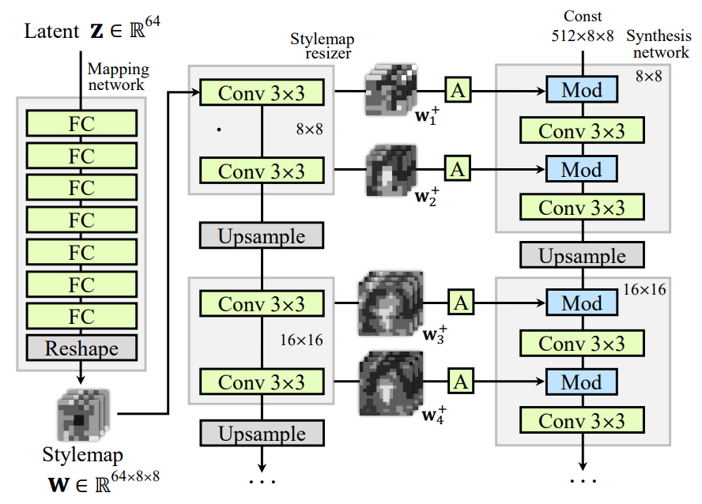
Stylemap-based generator
Traditional mapping network :
make style vectors to control feature map
-> create a stylemap with spatial dimensions
Projection of real image is effective at inference
Enable local editing

Slide 6
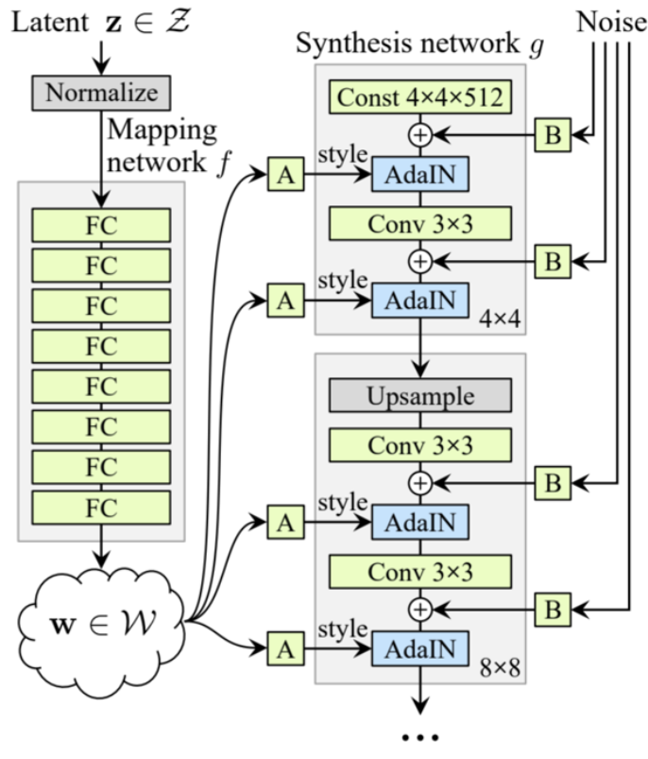
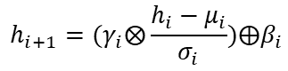
Stylemap-based generator
Match the resolutions of stylemaps
with the feature maps
Determine spatially
diverse affine parameters
Affine transform : produces parameters
for the modulation regarding resized stylemap
$$h_{i+1}=(γ_{i}⨂\frac{h_{i}−μ_{i}}{σ_{i}})⨁β_{i}$$
StylemapGAN
StyleGAN

Slide 7
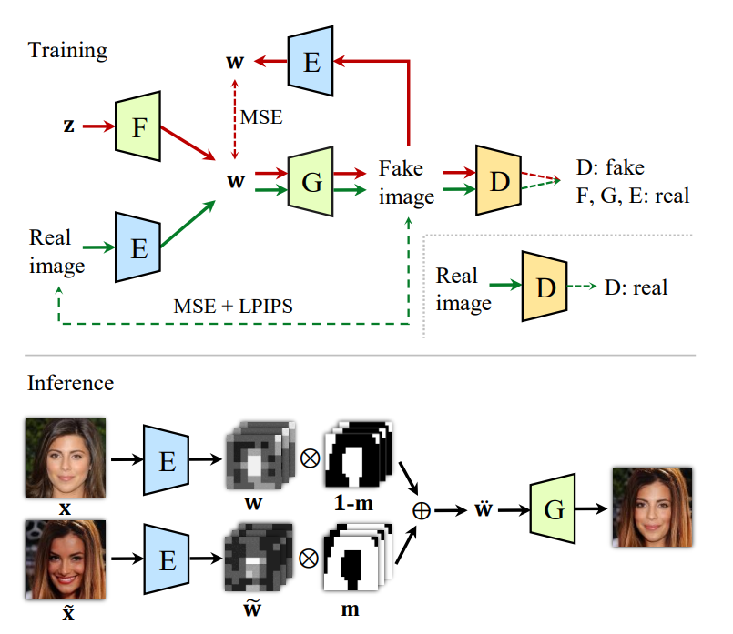
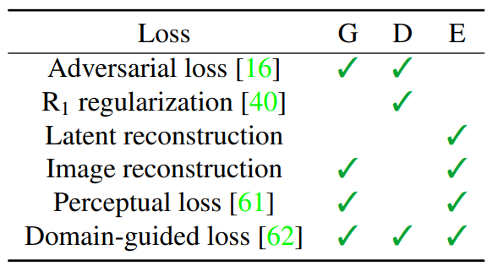
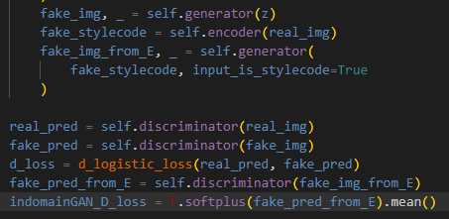
Training & Losses
Domain-guided loss : push projected latent code to remain
in the original latent space of GAN
(reconstruct images from the encoder tries to be classified as real)
Latent reconstruction loss : MSE in the w space
Image reconstruction loss : MSE in image pixel-level space
Perceptual loss : LPIPS
G and E are trained to reconstruct real images in pixel-level and perceptual-level
Image and E tries to reconstruct the stylemap with MSE
D attempts to classify the real images and the fake images
E tries to reconstruct more realistic images by competing with D
Notes:
Adversarial loss : Non saturating loss

Slide 8
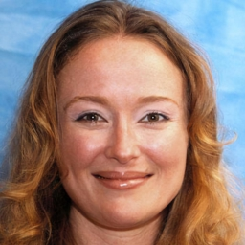
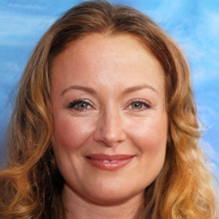
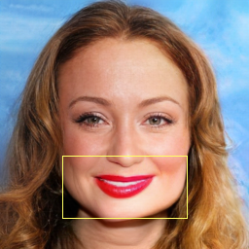
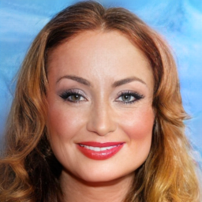
Experiments
<heavy makeup>
original
recon
local
global

Slide 9
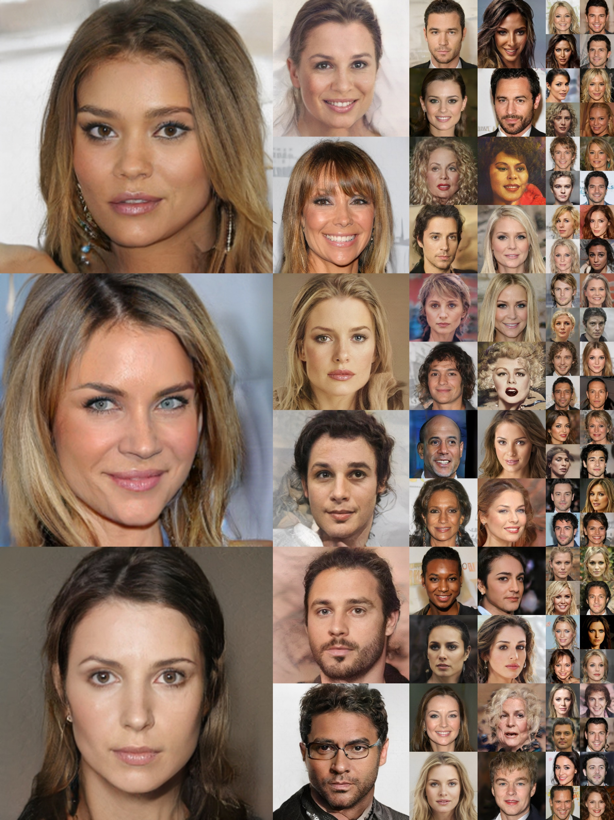
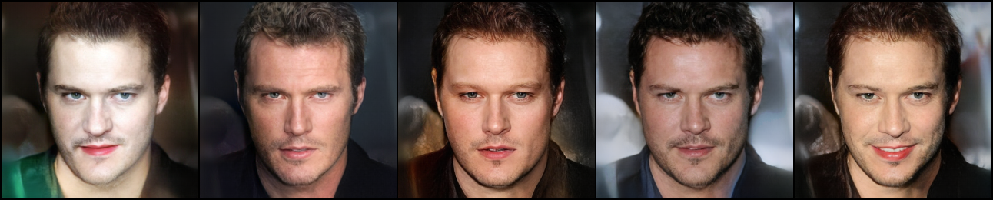
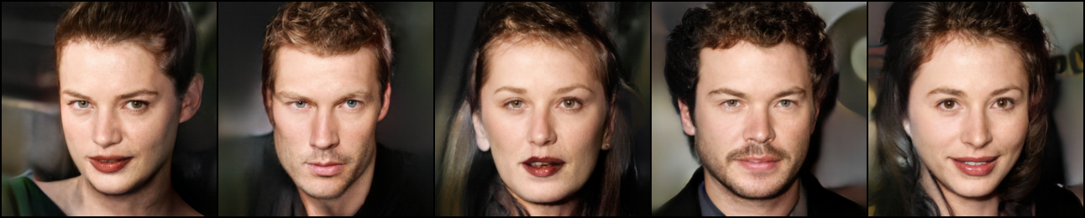

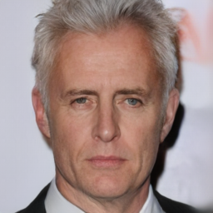
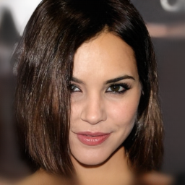
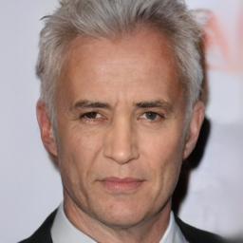
Experiments
Stylemixing(fine)
Stylemixing(coarse)
Random generation
Local editing(nose)

Slide 10
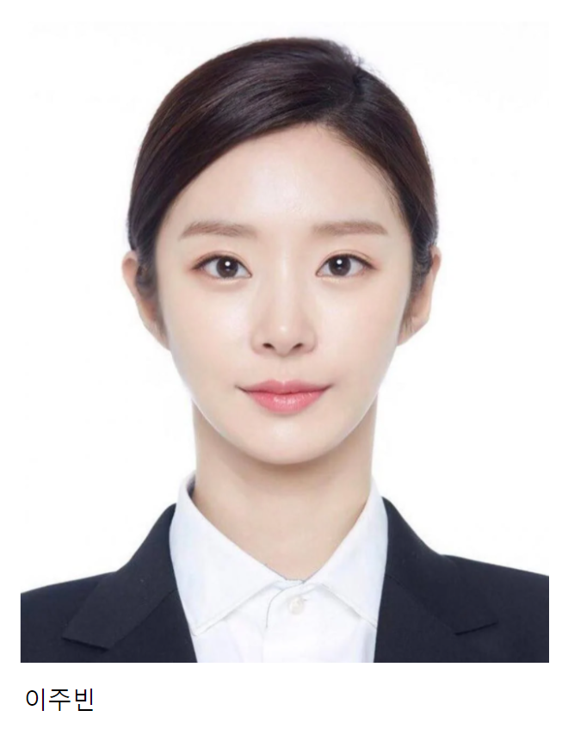
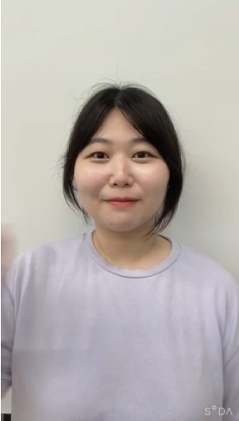
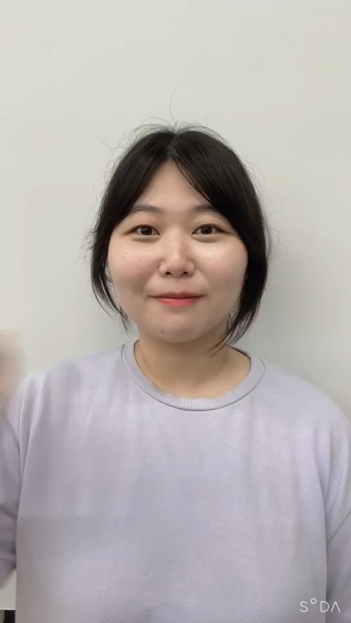
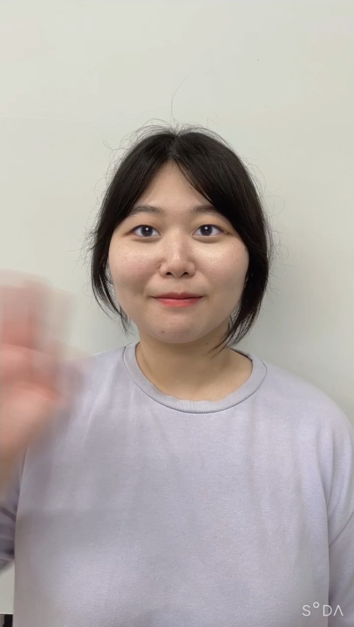
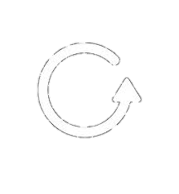

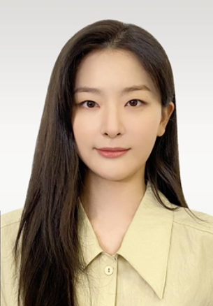
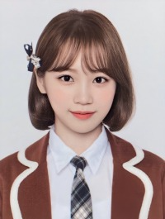
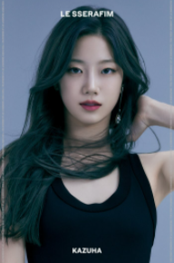
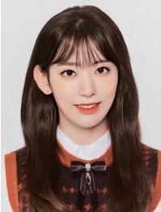
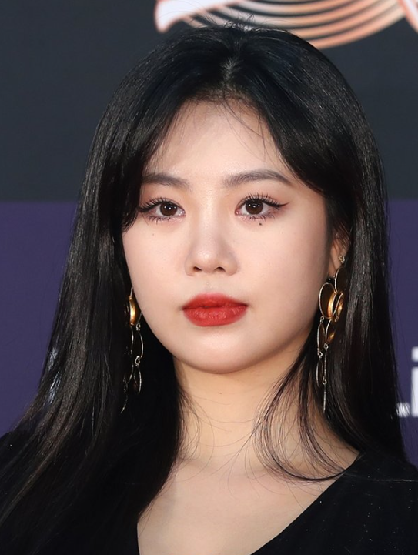
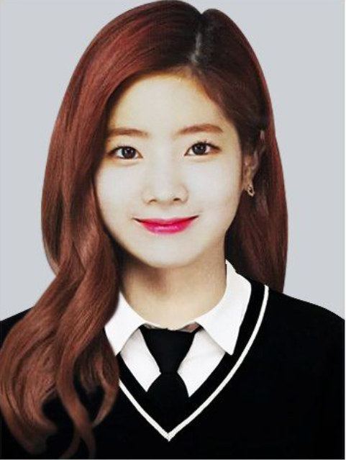
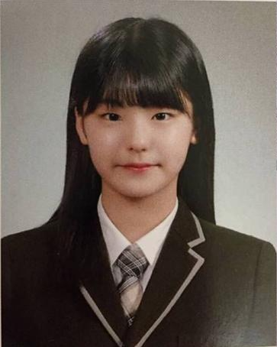
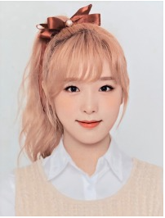
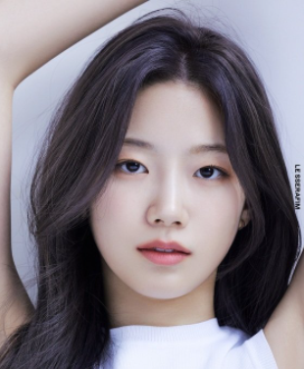
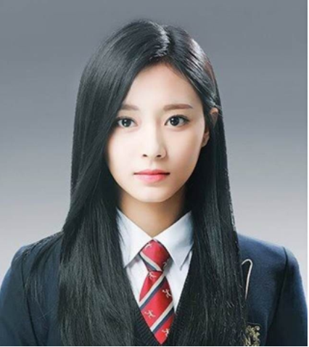
Prototype
localhost:0530
x
+
-
x
←
→
i
localhost:0530
Original video
Reference image
Generated video
*실제로 mask(눈)영역을 지정하는건 user가 원하는 부분을 색칠할 수 있습니다!
?
Selected Reference Images
Selected Images

Slide 11
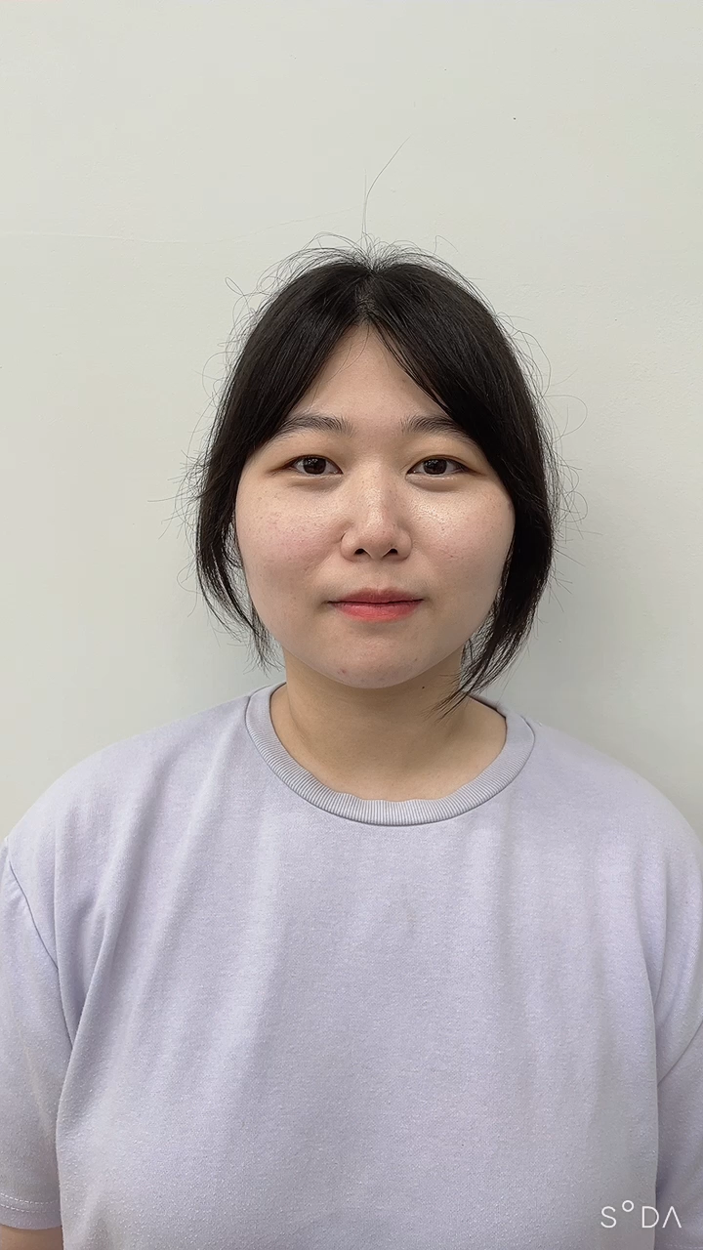
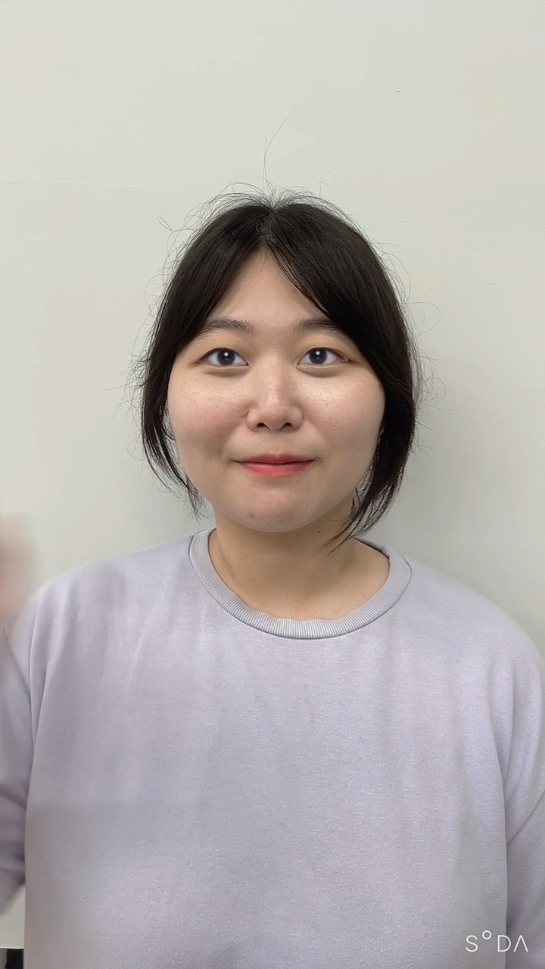
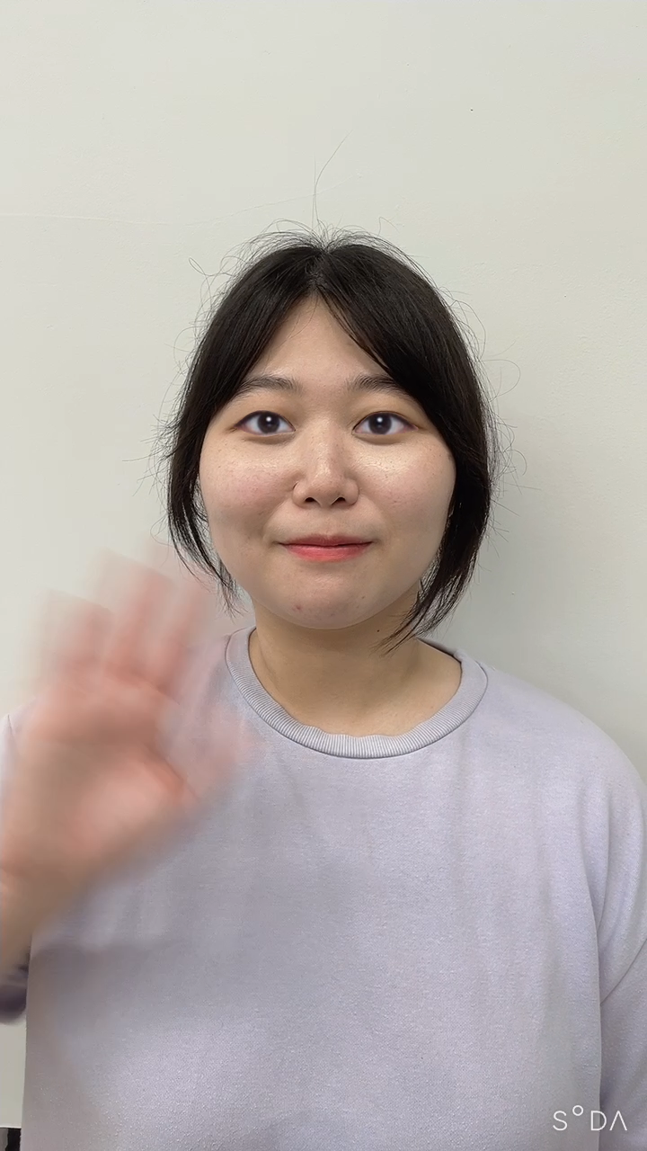
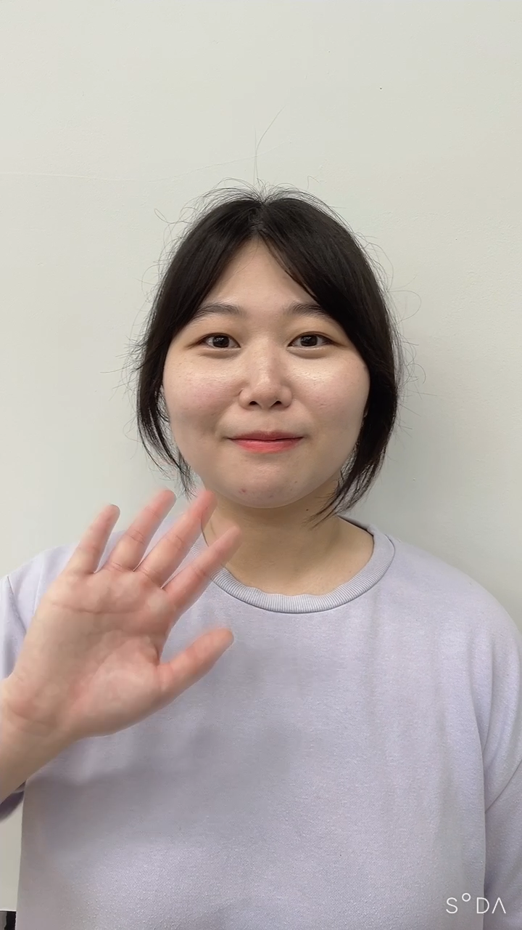
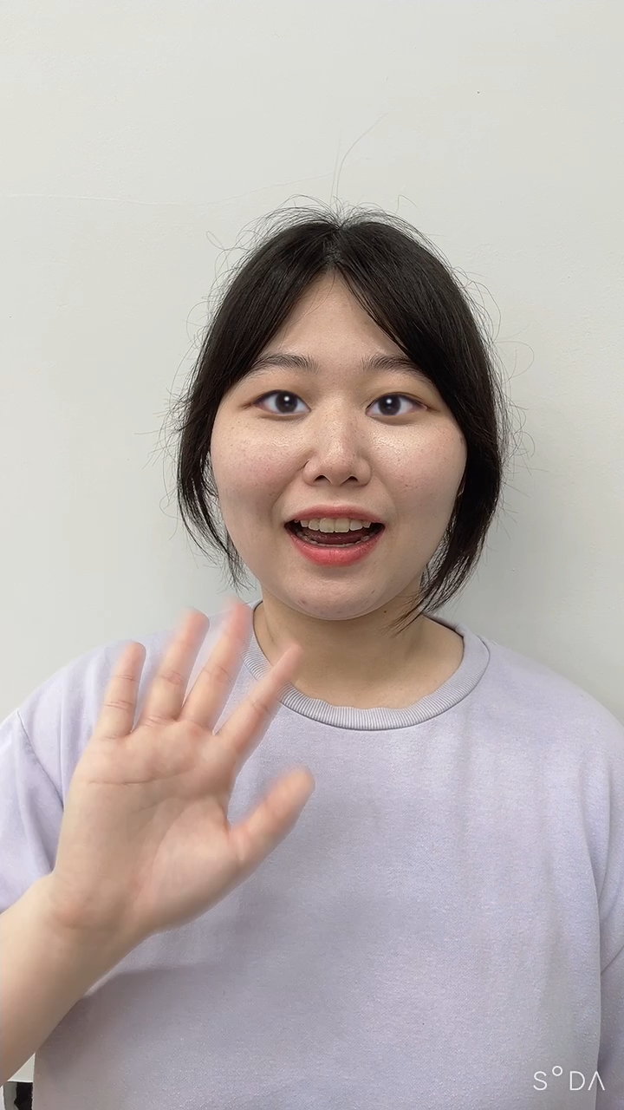

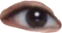
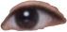
Pipeline
Frames
StyleMAPGAN
Video /Camera
Inference using only stylized keyframes and optical flow
Apply StyleMapGAN on keyframes
Mask
Extract key frame and optical flow
using flow-net
Output(video)

Slide 12
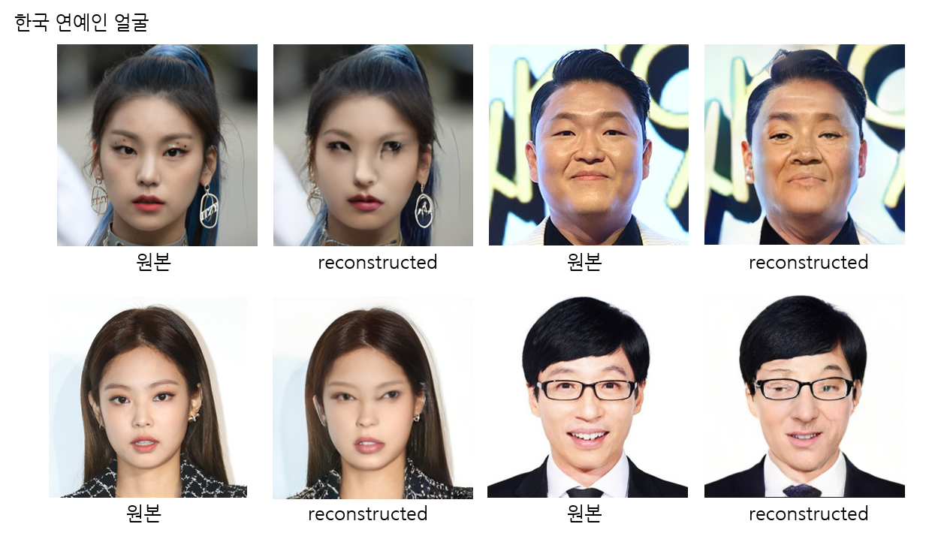
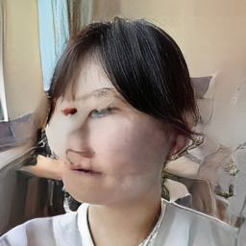
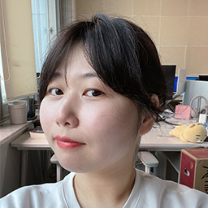
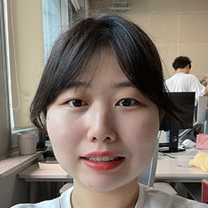
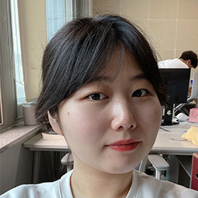
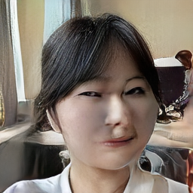
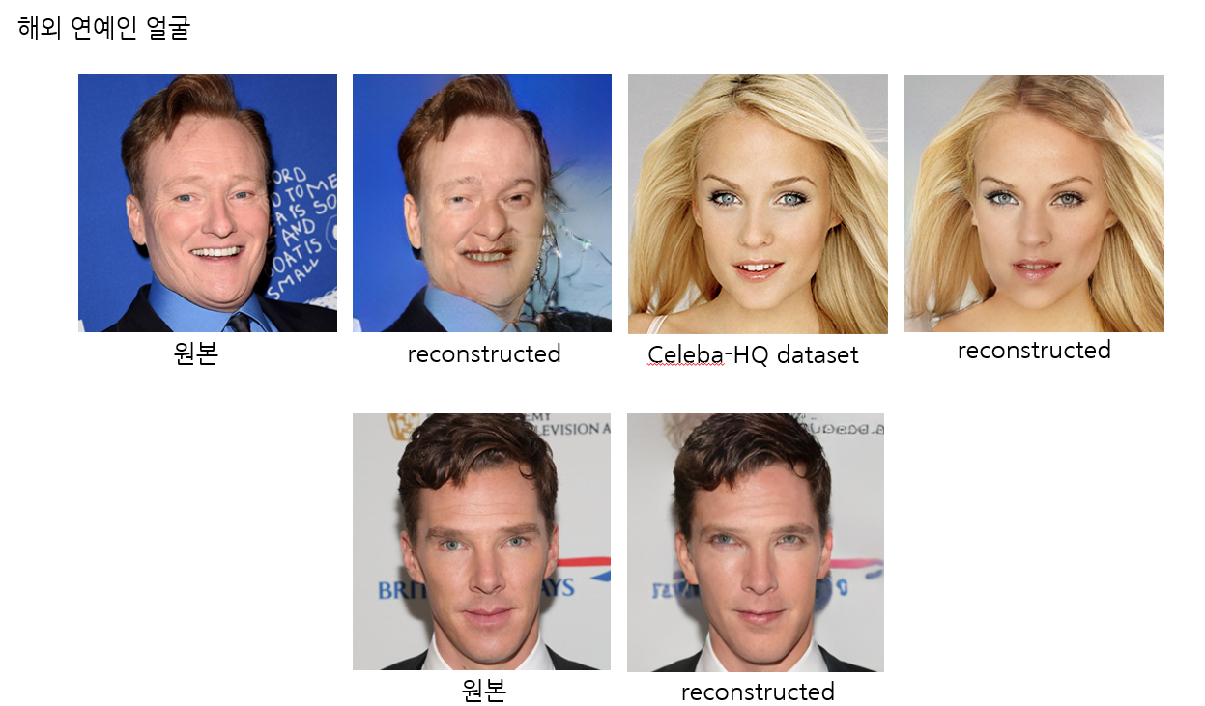
Problem & Future work
<Problem>
좌측 recon
좌측 원본
정면 원본
우측 원본
우측 recon
The reconstruction quality is low in the data on Asians.
2. Video generation can be unnatural when learning is conducted
only with one-way appearance data, such as front/rear, and
when the angle of a person's face is rotated to show a new aspect.

Slide 13
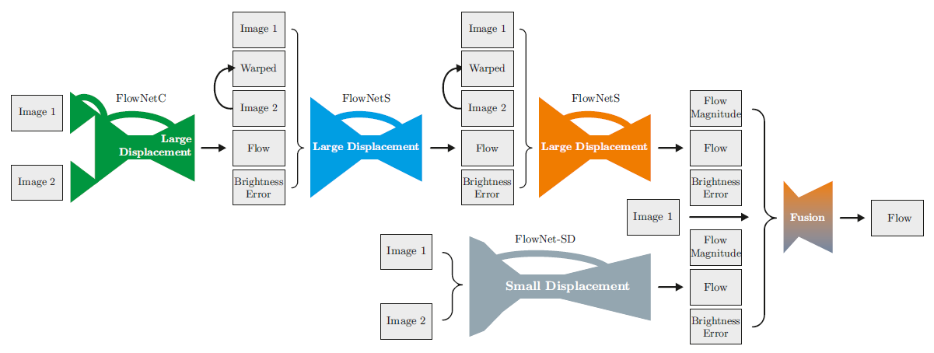
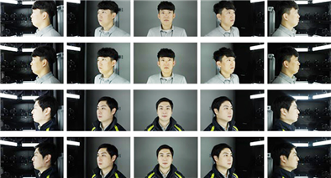
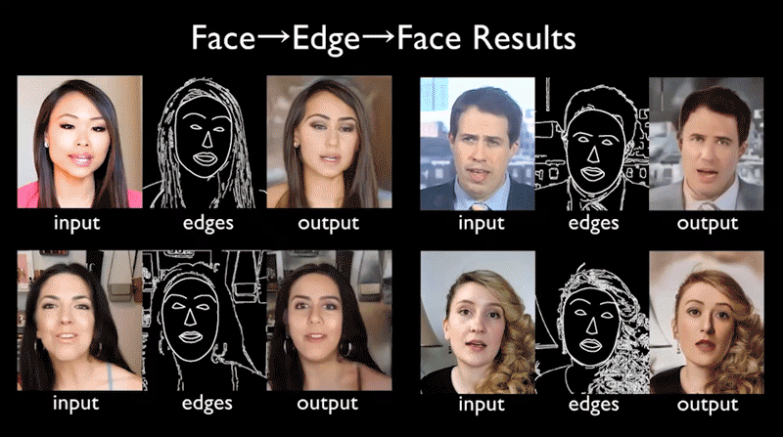
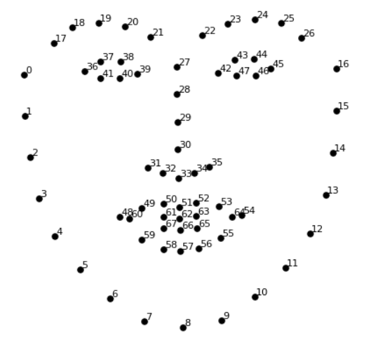
Problem & Future work
<Future work>
Train the model on K-face dataset
Use video generation through optical flow prediction
Extract the face landmark to calculate the main
coordinates of the eyes, nose, mouth and face contour
(face landmark detection)

Slide 14
Thank You!

